Slide 1
EDUp FORDCS V1.0 Project
Vienna, April.2022
Edu Platform
MSc. Ömer Karacan
karacankos@gmail.com
Template v2022.04

Slide 2
Project Purpose
To implement and test the FORDCS V1.0 based on customer requirements and Swagger API design!
Implementation and testing should be done on premise
The app should be deployed to Azure Cloud!

Slide 3
Project Requirements
The customer requirements are defined in a set of slides!
The FORDCS V1.0 API is designed by Swagger!
The app should offer a Swagger document API!
The app should be deployed to Azure Cloud!
The acceptance test should be conducted while app is running on Azure Cloud!

Slide 4
Project Technical Scope

Slide 5
Project Setup
For artifacts see the slide “FORDCS-V1.0 Project Artifacts”

Slide 6
Project Delivery

Slide 7
Additional Considerations

Slide 8
References

Slide 9
<Annex - > <topic name>>

Slide 10
Project Glossary

Slide 11
IDEA: funnel template is a check-list!
roles are important
customer deivers only the use cases --> customer req doc
assumption: customer has not technically profonde knowledge over the FORDCS
WHO is customer? SmartCity Gov!!??!!
EDUp is the supplier, has knowledge about the FORDCS
EDUp sys-req contains req-analysis based on use-use-cases --> state machine models and swagger design --> (analysis phase)
swagger design is input for validation test spec
Project STORY : Analysis design dev -- devops -- test : Dev Life-Cycle Story & PM story (work-funnels)

Slide 12
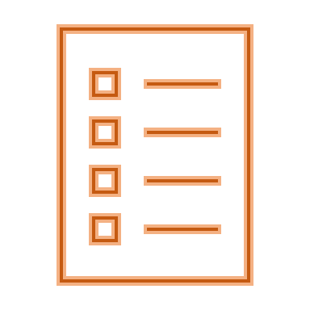

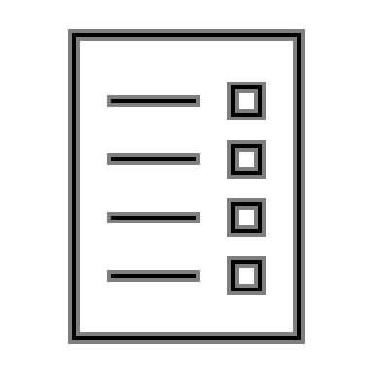






FORDCS-V1.0 Project Artifacts
<project>
Customer Requirements Document
<project>
Test Code
Project Setup Work-stream
FORDCS-V1.0
EDUp FORDCS-V1.0 Project-v2022.04
FORDCS-V1.0
EDUp-FORDCS-V1.0 Customer-Requirements-v2022.04.pptx
<project>
Validation Test Specification
Requirements Analysis Work-stream
<project>
System Requirements Specification
Acceptance Test Work-stream
<project>
Validation Test Specification
<project>
System Requirements Specification
System Test Work-stream
<project>
Test Code
<project>
Test Code
Architecture Design Work-stream
<project>
Architecture Design Specification
Test Code Work-stream
<project>
Architecture Design Specification
<project>
Validation Test Specification
Integration Test Work-stream
DevOps Document
Implementation Work-stream
<project>
Component Code
<project>
Verification Test Specification
<project>
DevOps Document
<project>
Component Code
DevOps Work-stream
Unit Test Work-stream
Cycles
Text Template: <artifact-name> work-stream)

Slide 13
Backyard

Slide 14
EDUp Project Story Stream Checklist
The < project-name>
Customer Scope
Define the system boundaries
Define the scope of the customer needs/requirements
Describe the needs from the viewpoint of customer (use case, swagger-UI, UX, big-picture)
Define the customer's knowhow profile
Supplier (Project) Scope
Define the system requirements from the viewpoint of supplier (describe with the means of Supplier's technology, tools, ..., HW/SW big-picture)
Define the supplier's knowhow profile
Define a project roadmap (project timeline)
Create artifacts according to EDUp-Full-Stack-Software-Project-Development-Method.pptx
See slide “Full-Stack Software Project Development Method” (#4)
Define the sys/sw-architecture covering the sys-req component-wise (SOA, component-based arch, domain model)
Define alternative solutions and references
Define the components based on Spring architecture
Define DevOps (the dev-env and dev-ops)
Define V&V-spec and -env
Define Deployment (deliverables, release content and media)

Slide 15
EDUp Project Story Stream
00
00
00
00
Customer Scope
00
00
00
00
Supplier Scope
User Scope

